Slide 1
Comprehensive SEO Audit & Optimization for Organic Traffic Growth
SHREYAS REDDY KANTHAREDDY

Slide 2
Company Selection:
The company select for this SEO project is “Infosys”. URL- https://www.infosys.com/services.html
About the company:
Infosys Limited is a global leader in next-generation digital services and consulting.
Founded in 1981 and headquartered in Bangalore, India, Infosys has grown to become one of the largest IT services companies in the world.
It provides a wide range of services, including IT consulting, software development, business process outsourcing, and digital transformation solutions.
Operates in over 50 countries worldwide and employs more than 343,000 employees globally (as of 2024).
Reported annual revenue of $18.21 billion for FY 2023.
Ranked as the 2nd largest IT services company in India after TCS.
Invested over $1 billion in R&D and digital transformation initiatives.

Slide 3
Initial Audit: used RankMath to analyze the site.
Current Performance:
Overall score is 68 out of 100 which is good.
Good usage of key words for better search results.
Most of the images have ALT attribute.
The webpage has valid robots.txt file to manage the crawling traffic.
The response time is under 0.2 seconds which is great.
The site is using a secure transfer protocol (https) to have a secure connection.
Strengths:
Meta description was found, and it is 155 characters long.
Keywords are found in both title and description.
The homepage is using canonical link tag which helps the search engine to show the main version of the webpage.
One or more H2 tags are used in the webpage.
34 images are having ALT attribute.
Weakness :
More than one H1 tags are use in the site. It is better to maintain just one H1 tag in each webpage.
The title of the homepage has 68 characters which is a bit more than the recommended.
14 images do not have ALT attribute.
Some CSS and JavaScript files don't seem to be minified. By minimizing these files, website speed will be improved.
The site makes 61 requests. A large number of requests can result in slow page loading.

Slide 4
2. Keyword Research: Used google keyword planner to identify primary, secondary, and long tail keywords.
Primary Keywords:
Blockchain Technology
Blockchain development Course
Data Analytics
Data Science
Supply chain management
SCM software
Secondary Keywords:
Blockchain consulting services
Blockchain app development
Business Analytics
Data mining and predictive analytics
Supply chain for digital products
Long Tail Keywords:
Blockchain technology for enhancing supply chain resilience
Identity management system using blockchain
Business intelligence guidebook from data integration to analytics
MySql for data analytics and business intelligence
Supply chain 4.0 the next generation digital supply chain
Digital technology in supply chain management

Slide 5
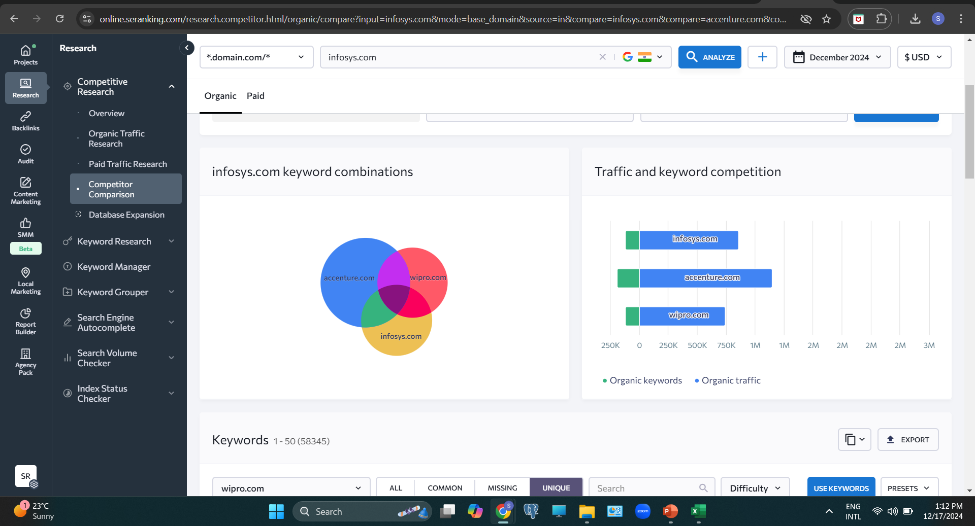
Competitive Analysis:
Wipro and Accenture are the direct competitors for Infosys.
Accenture has a greater number of keywords when compared to Infosys.
Keywords:
Accenture- 1,26,985
Infosys- 63,739
Wipro- 58,345
Common between 3 companies – 21,527

Slide 6
3. On-Page SEO Optimization Audit: Used SEO tools such as Aioseo and SEO Meta to audit the webpages.
Page 1: Blockchain page from Infosys, URL- https://www.infosys.com/services/blockchain.html
Meta title (53) and description (156) is properly written within the recommended characters.
Only one H1 tag is been used which is good.
There are 36 images with ALT attribute and 24 images with ALT attribute.
59 images are without descriptive title.
Keywords are very well utilized in both content and headings, but there is keyword stuffing.
There are 300 internal links and 43 external links in this webpage. Used Aioseo tool to analyze links.
Uses canonical tag to prevent duplication of the original webpage.

Slide 7
3. On-Page SEO Optimization Audit: Used SEO tools such as Aioseo and SEO Meta to audit the webpages.
Page 2: Data Analytics page from Infosys, URL- https://www.infosys.com/services/data-analytics.html
Meta title (53) and description (146) is properly written within the recommended characters.
H1 tag is not used in the webpage. There should be one H1 tag present in each webpage.
There are 36 images with ALT attribute and 21 images with ALT attribute.
56 images are without descriptive title.
Keywords are very well utilized in both content and headings.
There are 294 internal links and 42 external links in this webpage. Used Aioseo tool to analyze links.
Uses canonical tag to prevent duplication of the original webpage.

Slide 8
3. On-Page SEO Optimization Audit: Used SEO tools such as Aioseo and SEO Meta to audit the webpages.
Page 3: Digital Supply Chain page from Infosys, URL- https://www.infosys.com/services/digital-supply-chain.html
Meta title (59) and description (145) is properly written within the recommended characters.
Only one H1 tag is been used which is good.
There are 37 images with ALT attribute and 20 images with ALT attribute.
56 images are without descriptive title.
Keywords are very well utilized in both content and headings. But there is keyword stuffing for the keyword ‘Supply Chain’.
There are 302 internal links and 42 external links in this webpage. Used Aioseo tool to analyze links.
Uses canonical tag to prevent duplication of the original webpage.

Slide 9
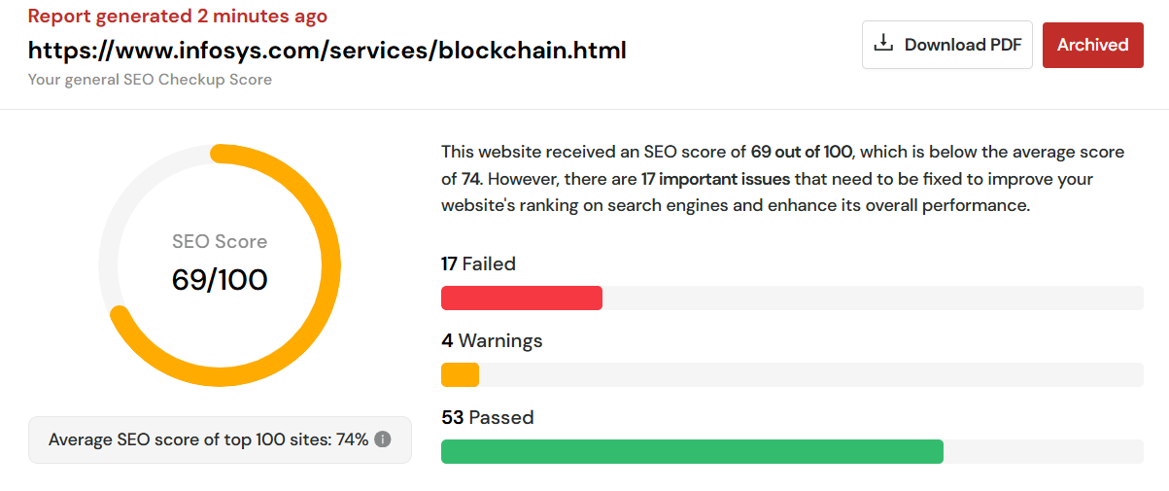
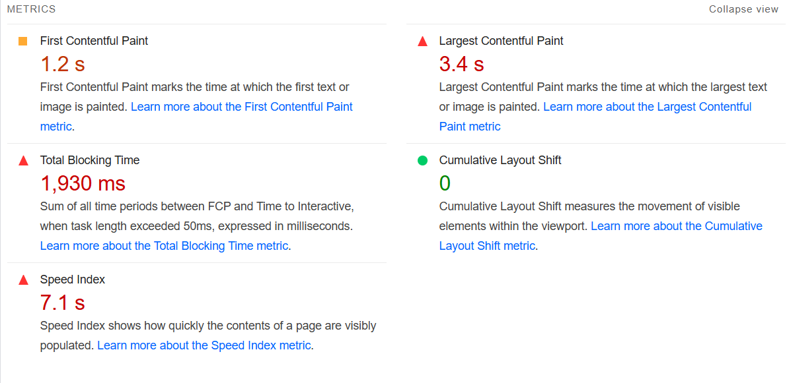
4. Technical SEO: Used SEO tools SEOsitecheckup.com to audit the webpages.
Page 1: Blockchain page from Infosys, URL-https://www.infosys.com/services/blockchain.html
The overall SEO score for this page is 69%, which is awarded by SEOsitecheckup.com.
There are no problems in accessing the website, meaning the crawlability is good.
There is a good canonical link provided.
The size of this webpage's HTML is 50.64 Kb and is greater than the average size of 33 Kb. This can lead to slower loading times.
3 broken links were found (used deadlinkchecker.com).
This website is not using a custom 404 error page. Default 404 error pages result in a poor experience - it can mislead users into thinking an entire site is down.

Slide 10
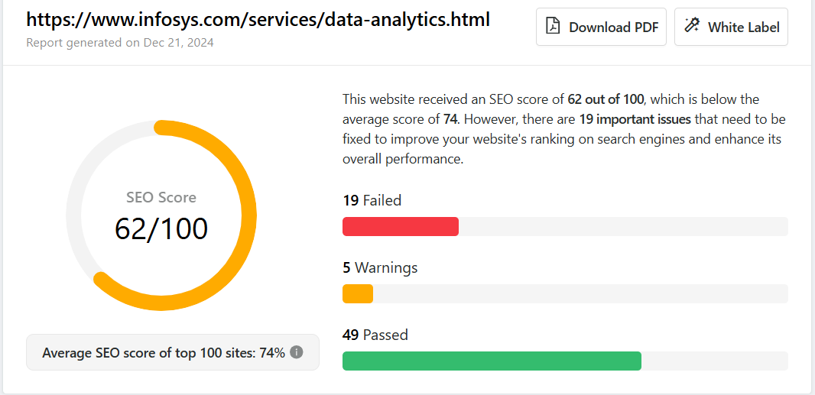
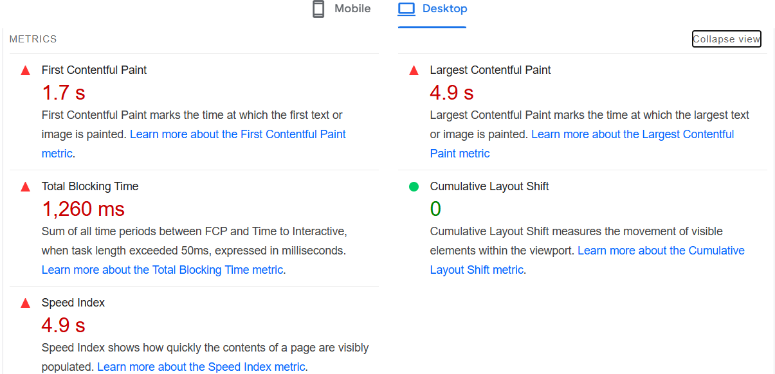
4. Technical SEO: Used SEO tools SEOsitecheckup.com to audit the webpages.
Page 2: Data Analytics page from Infosys, URL- https://www.infosys.com/services/data-analytics.html
The overall SEO score for this page is 62%, which is awarded by SEOsitecheckup.com.
This webpage's DOM has 1,631 nodes, exceeding the recommended 1,500, which harms performance and slows page load time.
1 broken link found (used deadlinkchecker.com)
There is a good canonical link provided.
To provide a good user experience, the Largest Contenful Paint duration of 2.5 seconds or less but here it is 4.9s.
Minify CSS and JavaScript files to improve performance, enhance caching, and reduce loading times.

Slide 11
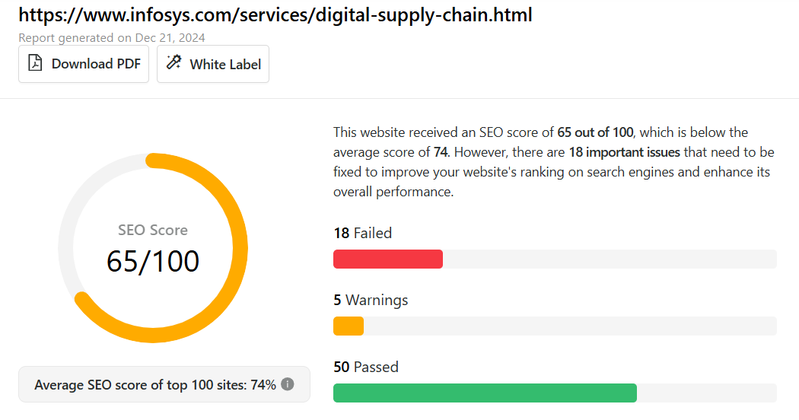
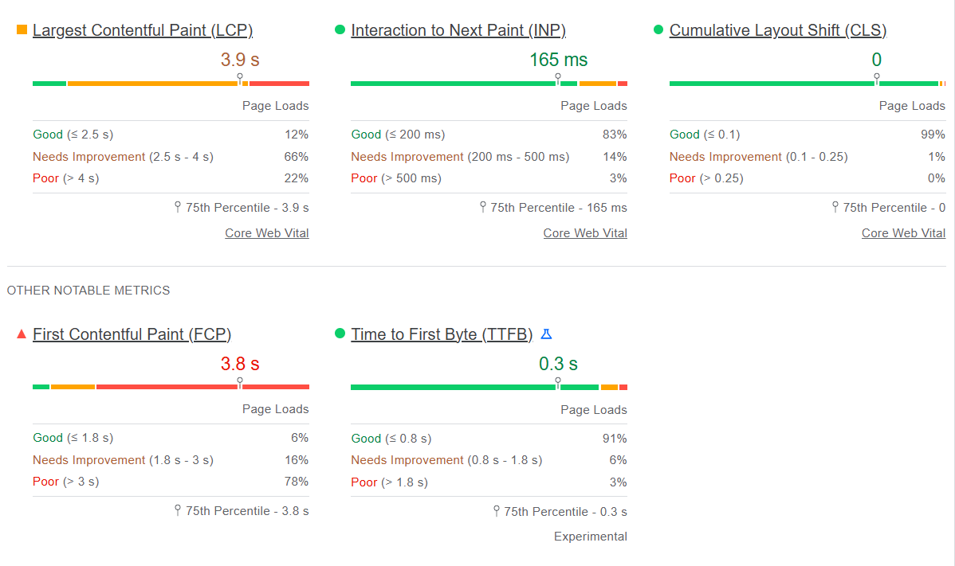
4. Technical SEO: Used SEO tools SEOsitecheckup.com to audit the webpages.
Page 3: Digital Supply Chain page from Infosys, URL- https://www.infosys.com/services/digital-supply-chain.html
The overall SEO score for this page is 65%, which is awarded by SEOsitecheckup.com.
This webpage’s Document Object Model (DOM) has 1,620 nodes, exceeding the recommended 1,500, which harms performance and slows page load time.
Robots meta tag is missing in the webpage, it tells how search engines crawl, index, and interact with individual web pages, helping optimize SEO and manage visibility.
There is a good canonical link provided.
3 broken links were found (used deadlinkchecker.com)
Largest contentful paint is 3.9s and first contentful paint is 3.8s.
Minify CSS and JavaScript files to improve performance, enhance caching, and reduce loading times.

Slide 12
Five best practices to improve site and web page speed
Minify CSS, JavaScript, and HTML
Optimize the images.
For the best SEO results there should be exactly one H1 tag on each page.
Reduce redirects because it can slow the webpage by 50%
Use browser caching, this allows browsers to store recent web pages on the server, so they load faster when users request them.

Slide 13
5. Content Strategy: Develop a content strategy plan based on keyword research.
Blog topics related to the targeted keywords:
"Top 5 Real-World Applications of Blockchain You Should Know About“
"Top Skills You’ll Learn in a Blockchain Development Course“
"From Raw Data to Insights: The Power of Modern Data Analytics“
"Data Science vs. Data Analytics: Understanding the Key Differences“
"Digital Supply Chain Management Trends to Watch in 2024“
"Why SCM Software is a Game-Changer for Small and Medium Businesses“
Write in-depth blog posts on these topics to attract the targeted audience.
Create videos on these topics because understanding a topic visually is more comfortable.
Publish articles/paper and upload it on google scholar.
Share these blog posts and videos on linkedin, facebook, and twitter for better reach.
Keep a dedicated team for content creation.

Slide 14
6. Off-Page SEO: Create an Off-page SEO plan and Strategy for the selected website.
Building high quality backlinks by targeting industry related websites where they write articles.
If any links are broken, it is better to replace those broken links because these links can negatively impact on both user experience and SEO performance.
Make use of the social media platform such as twitter and linkedin to share the content and recent case studies.
Can conduct various activities like polls by joining in the relevant groups on linkedin and share visual content on the current topics.
Should conduct live webinars and events by collaborating with experts for wider reach.
Maintain consistent business information such as name, address, phone number, services, and products across all the online directories which strengthens the search results.
After a successful project or a service, it is better to ask the client to leave a feedback or a review by providing direct links review website.

Slide 15
THANK YOU

